Slide 1

BIG MOUNTAIN RESORT PROFITABILITY MODEL
Big Mountain SKI Resort
Whitefish SKI Resort

Slide 2
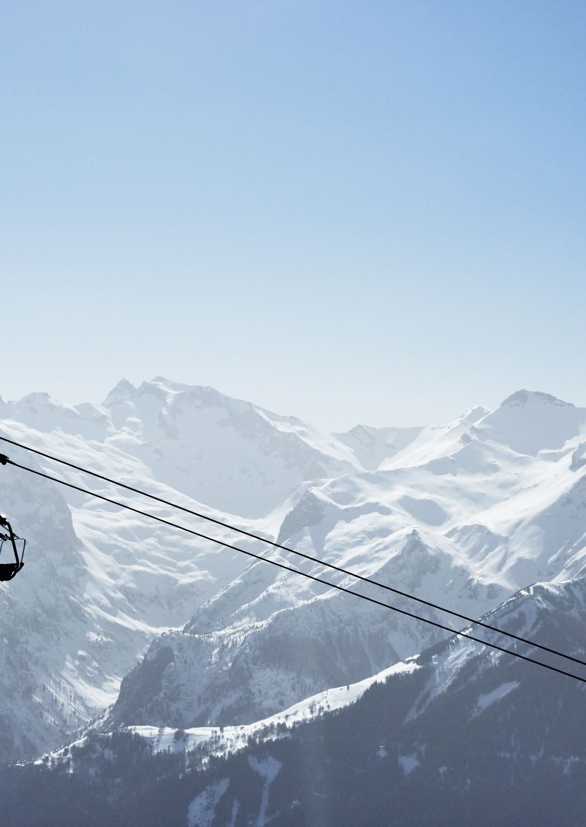
PROBLEM IDENTIFICATION
Instillation of an additional chair lift.
Big Mountain Resort has increased their operating costs by $1,540,000 from instillation of chair lift
Possible methods of reducing operational costs
Possible Methods of increasing revenue

Slide 3
PROBLEM IDENTIFICATION
The criteria for success for this project is to see savings and additional revenue that when added together totals to $1,600,000 or more to offset the additional operating costs of the new chair lift.
The time period for this project is the end of the current winter season.

Slide 4
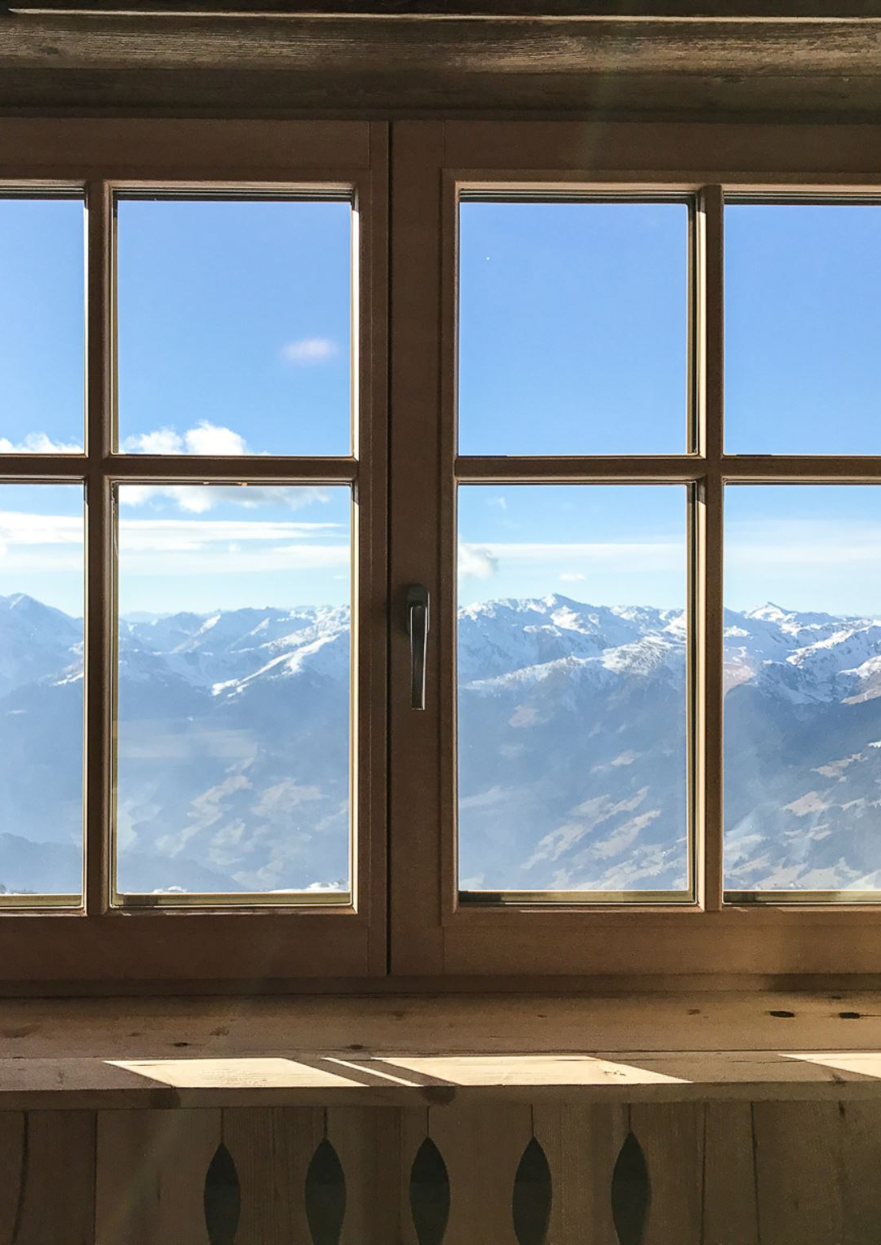
RECOMMENDATIONS AND KEY FINDINGS
Our current price is $81.00
Highest in the state of Montana
Leaders in almost every category in the state.
Big Mountain Resort modelled price is $95.87, actual price is $81.00.
Even with the expected mean absolute error of $10.39, this suggests there is room for an increase.

Slide 5
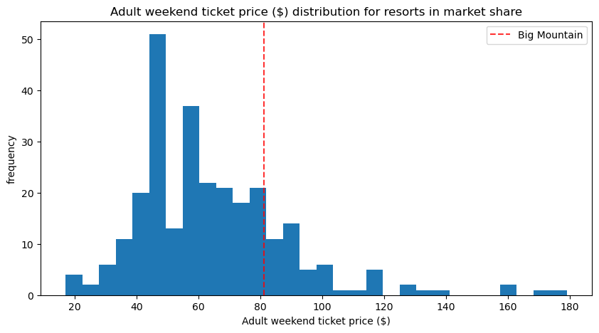
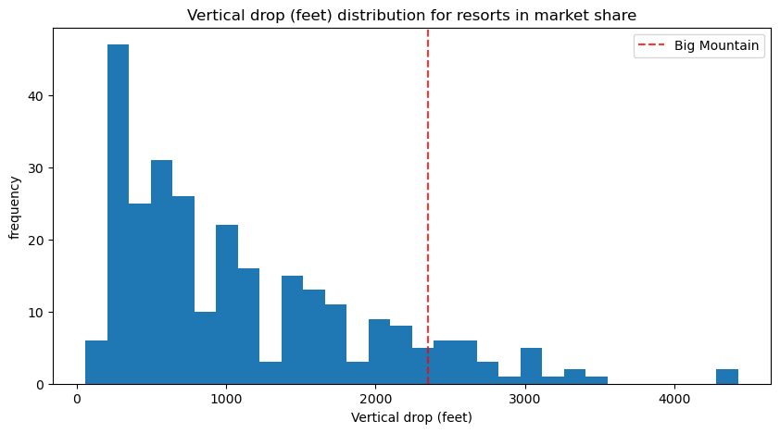
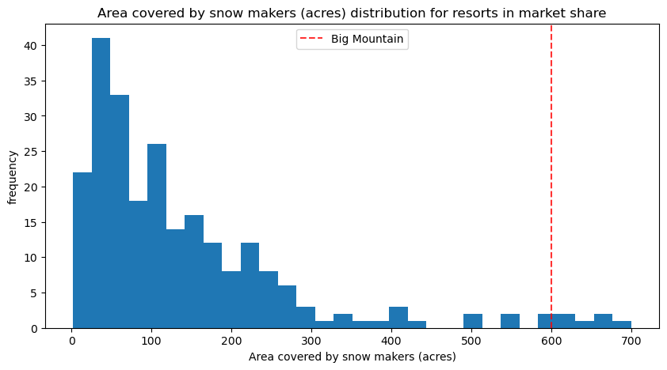
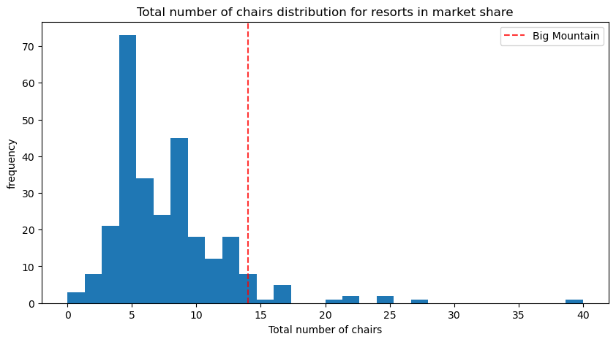
MODELING RESULTS AND ANALYSIS

Slide 6
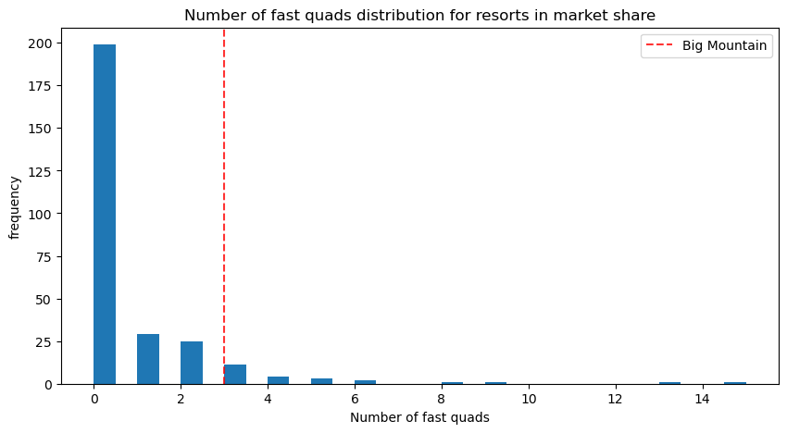
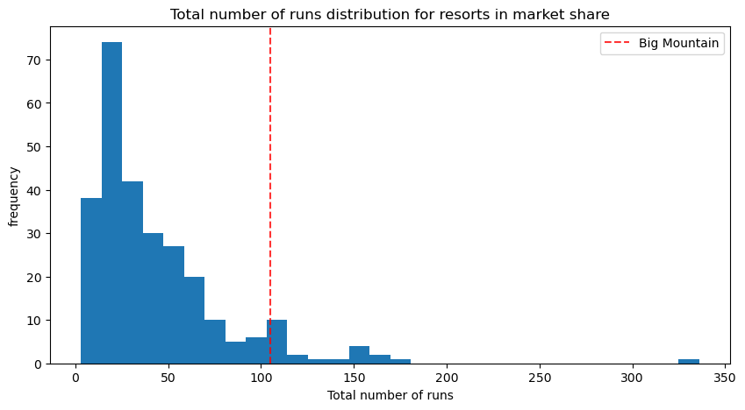
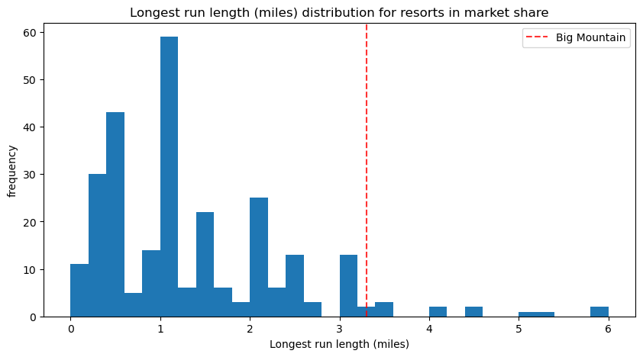
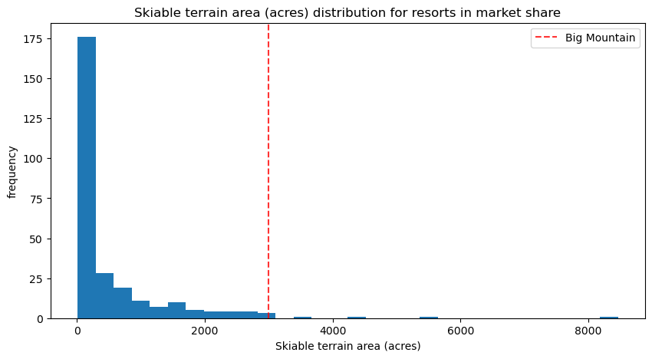
MODELING RESULTS AND ANALYSIS

Slide 7
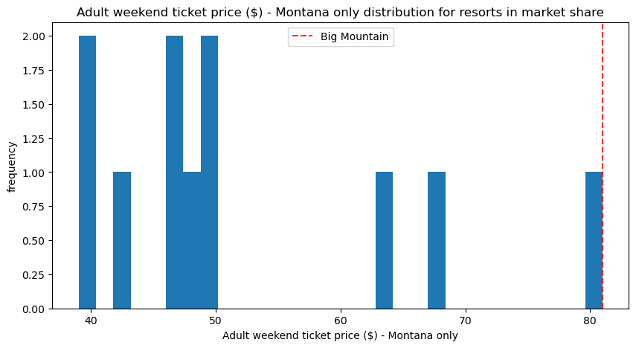
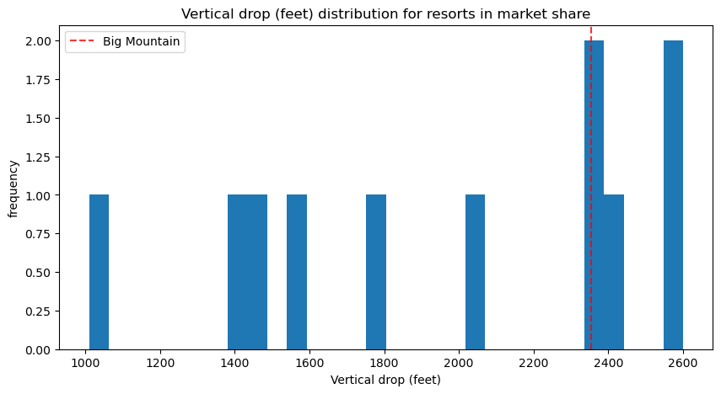
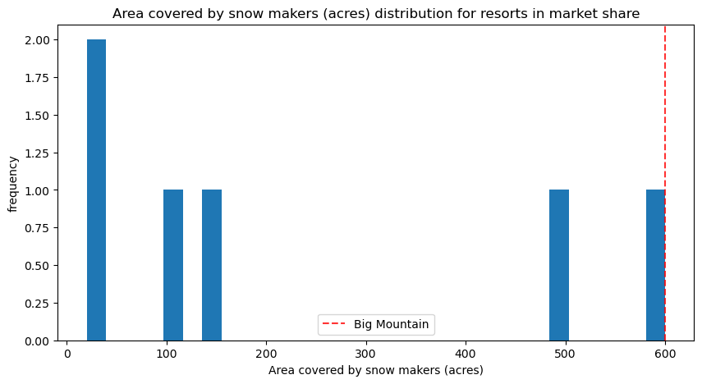
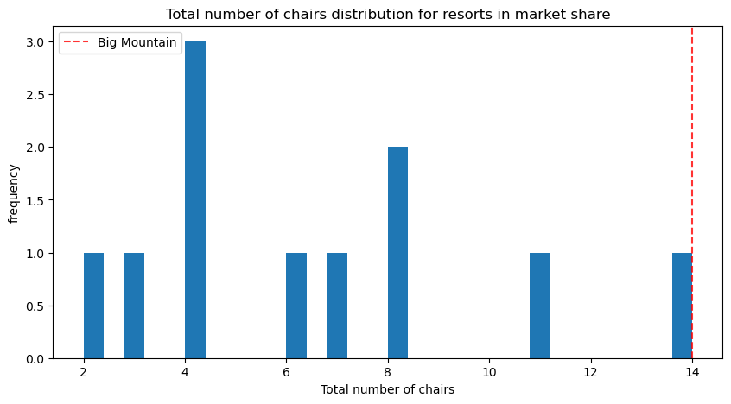
MODELING RESULTS AND ANALYSIS

Slide 8
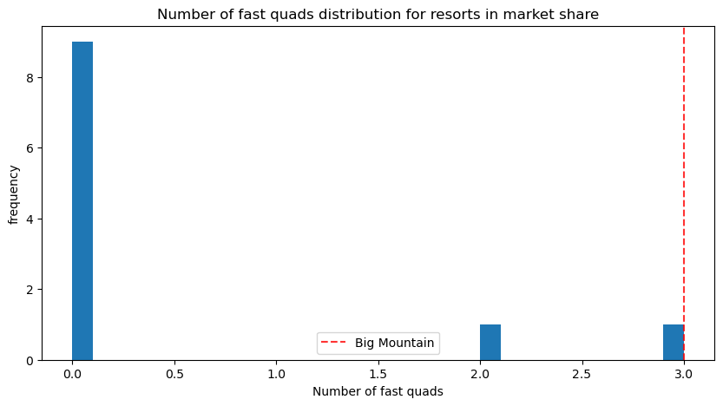
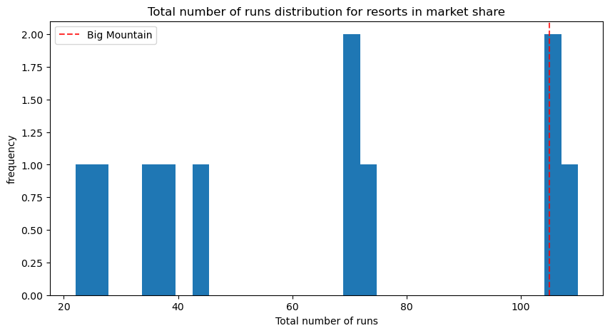
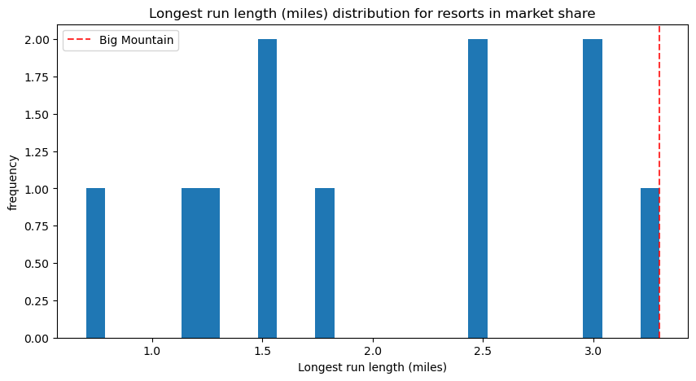
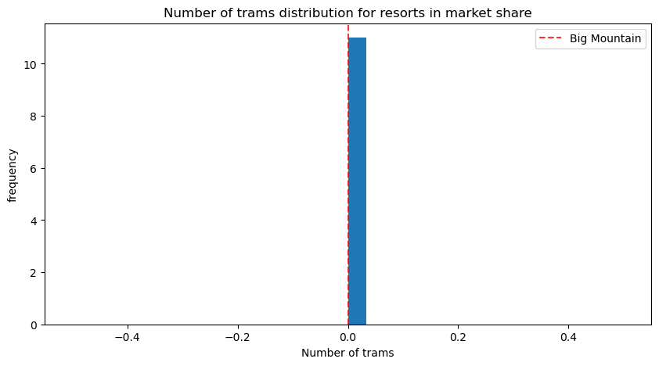
MODELING RESULTS AND ANALYSIS

Slide 9
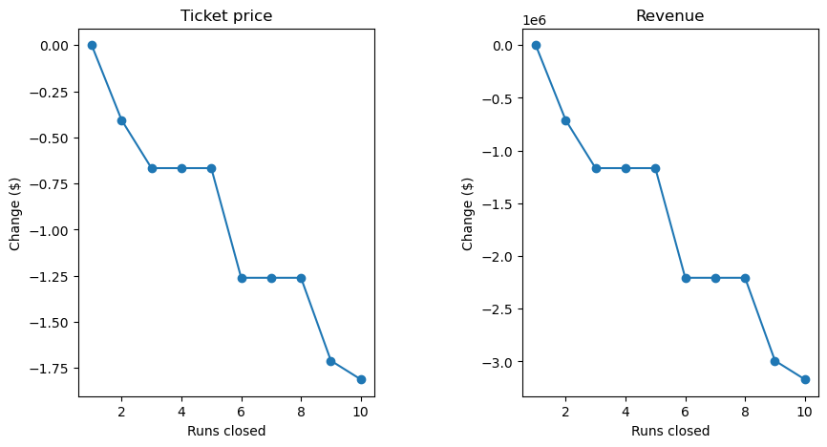
SUMMARY
Closing one run makes no difference.
Closing 2 and 3 successively reduces support for ticket price and so revenue.
If closes 3 runs, may as well close 4 or 5 as there's no further loss in ticket price.
Closing runs ultimately decreases revenue

Slide 10
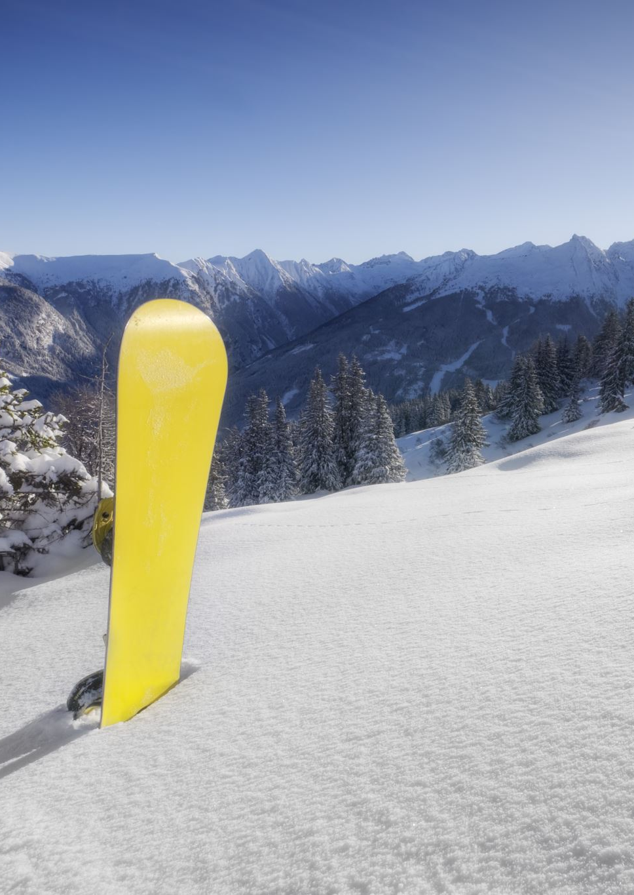
SUMMARY
Increasing ticket price
Adding a couple more features to our park
Increase the vertical drop by 150 feet
Add an extra run
Add an extra chair
Increase the ticket price by $1.99, bringing the price up to $83.99
$3,474,638 in total extra income with $1.99 increase
Consider the additional operating cost

Slide 11
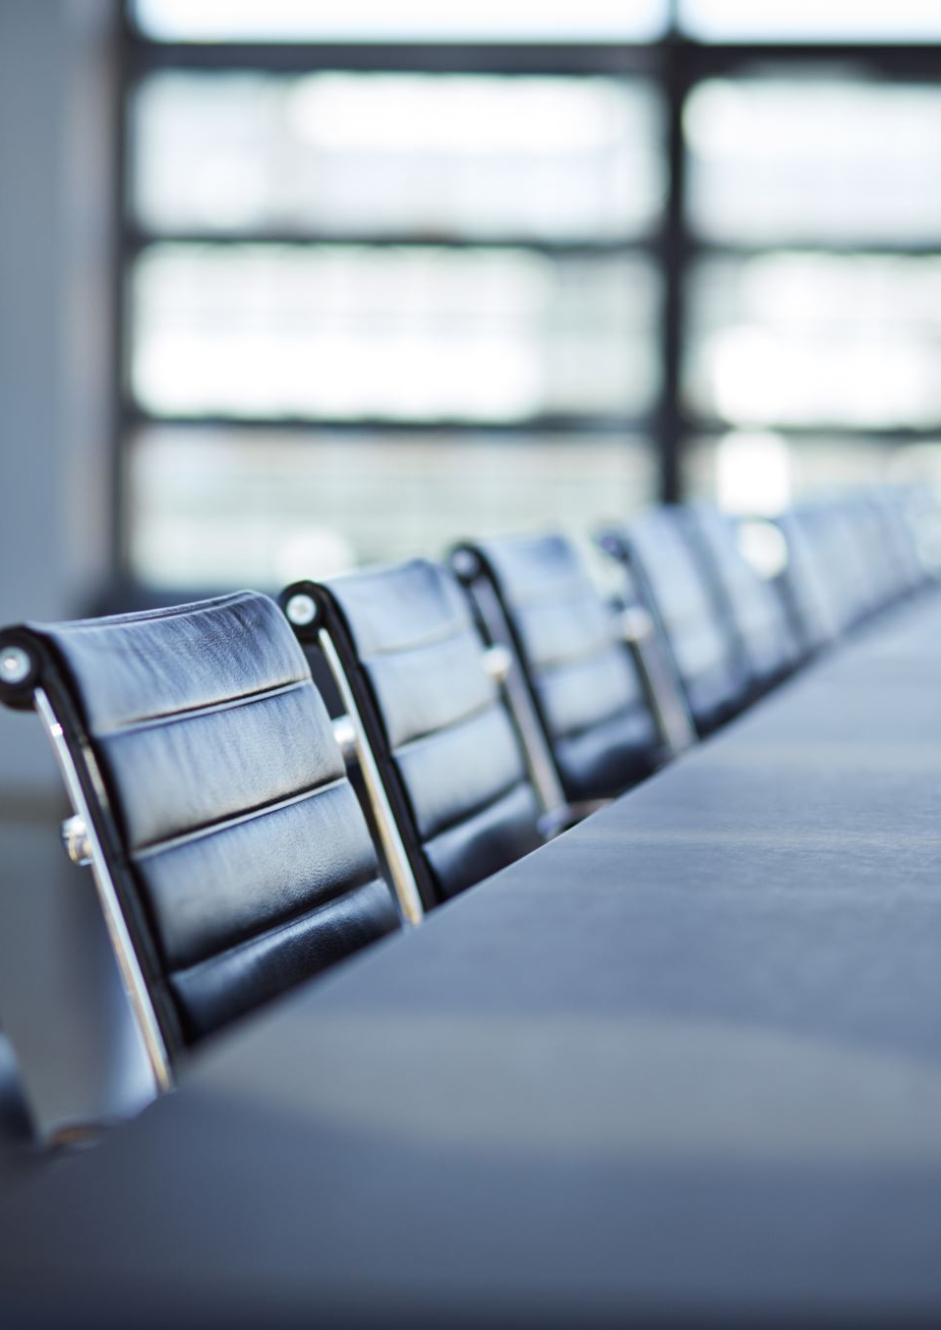
CONCLUSION
I ultimately believe that increasing the overall ticket price to $86 will be the best idea. That amount will cover the additional operational cost of increasing the drop, runs, and chairs, as well as offsetting the cost of the lift and providing us with additional capital to do whatever we please such as reinvesting back into the resort or increasing worker’s salary. It is not such a huge increase is to deter visitors and when they see there is a larger vertical drop and an extra chair and run to go alongside the new ski lift, they will feel like their money is well spent.

